Slide 1

Voxellancer
I believe I can fly
by Christian Dullweber and Moritz Eyssen, Sebastian Gerstenberg and Patrick Siegler
under guidance of Daniel Limberger

Slide 2
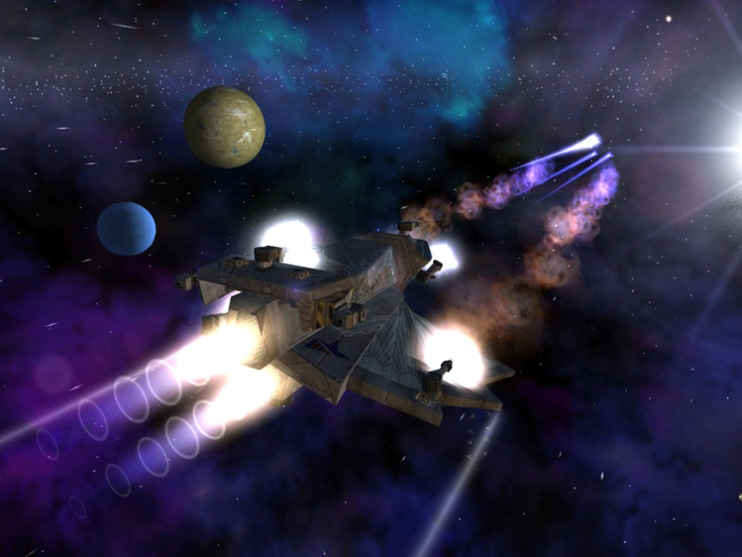
Motivation Space
Space games are awesome
Dogfight combat
Science fiction setting
Open world
Not limited by „realism“
As previously seen in games like:
Freelancer
X-Series
Eve Online

Slide 3
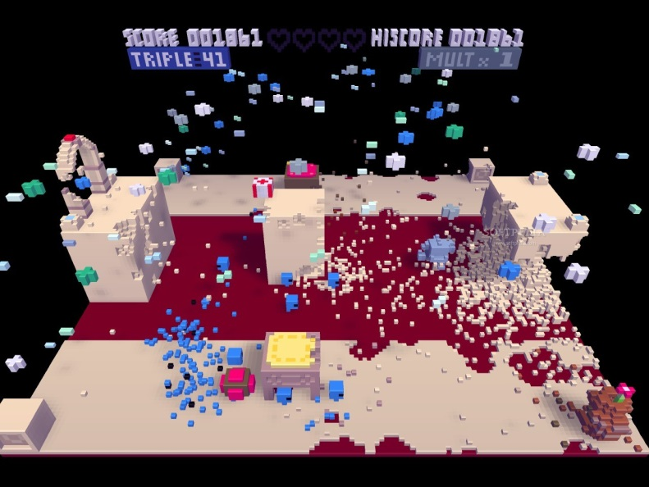
Motivation Voxels
Fully destructable world
Accurate textbook physics:
collision
destruction
Impacts
Simple model design
As previously seen in games like:
Voxatron
Minecraft

Slide 4
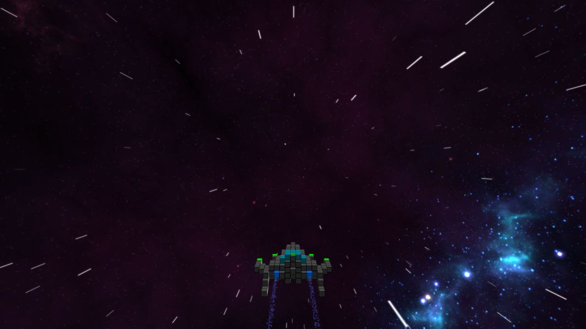
Trailer

Slide 5
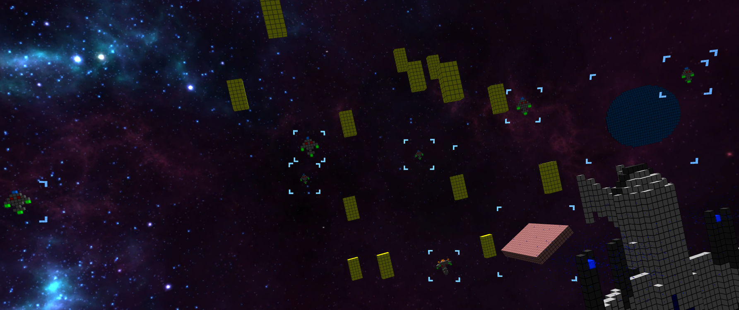
Features

Slide 6
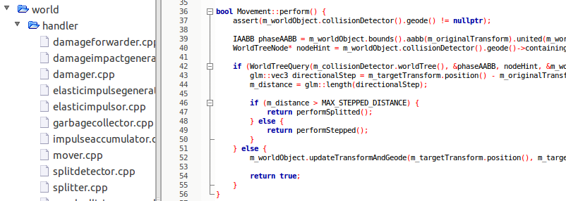
Engine
Physics
CollisionDetection
Damage
Splitting

Slide 7
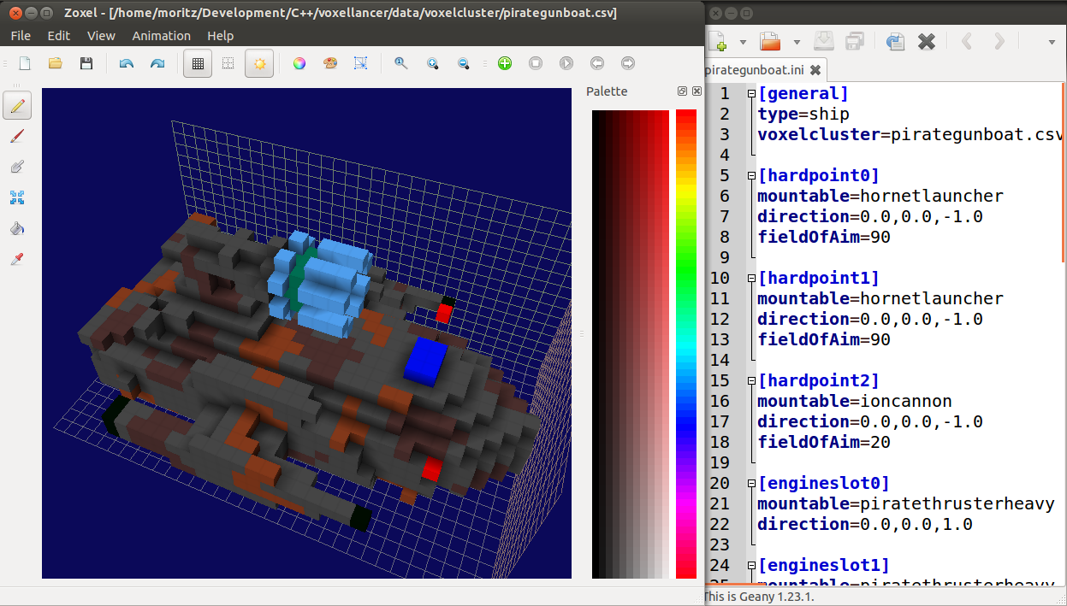
Modeling

Slide 8
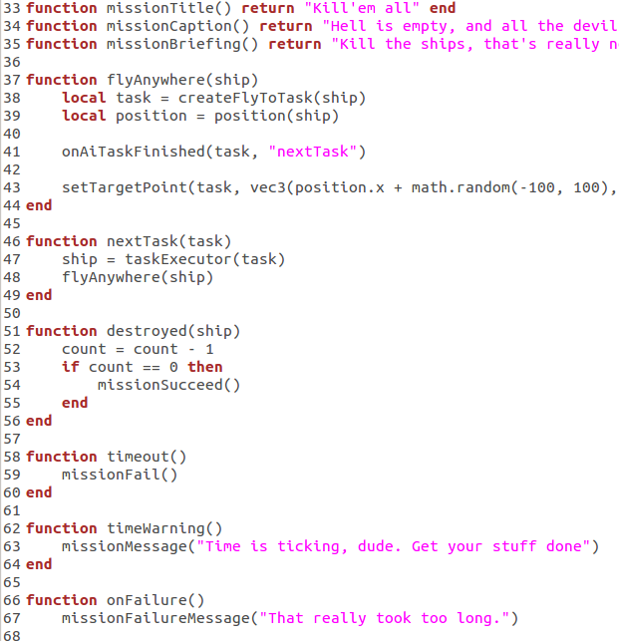
Scripting

Slide 9
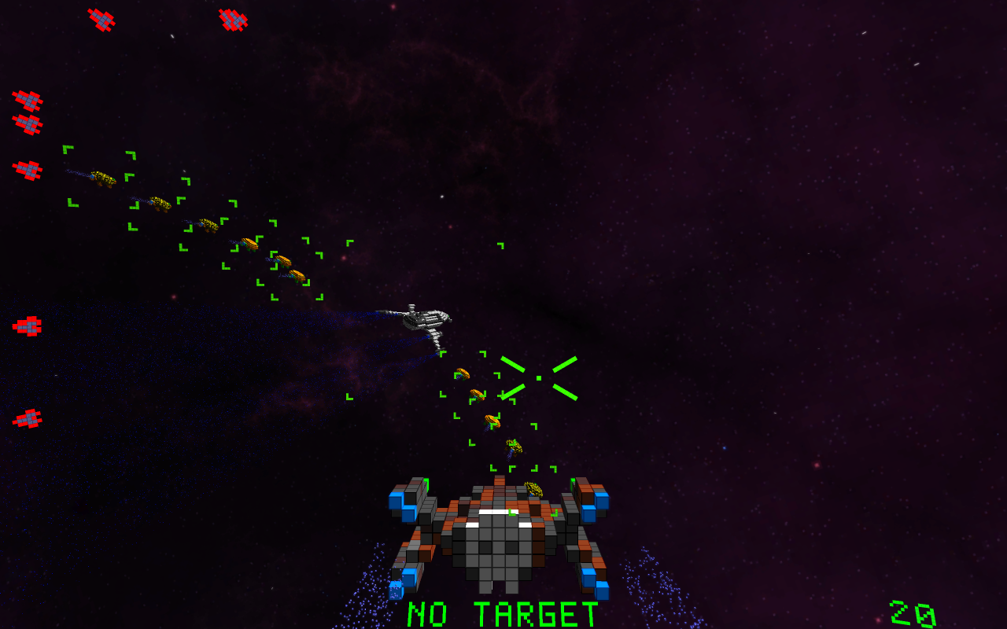
AI and Squads

Slide 10
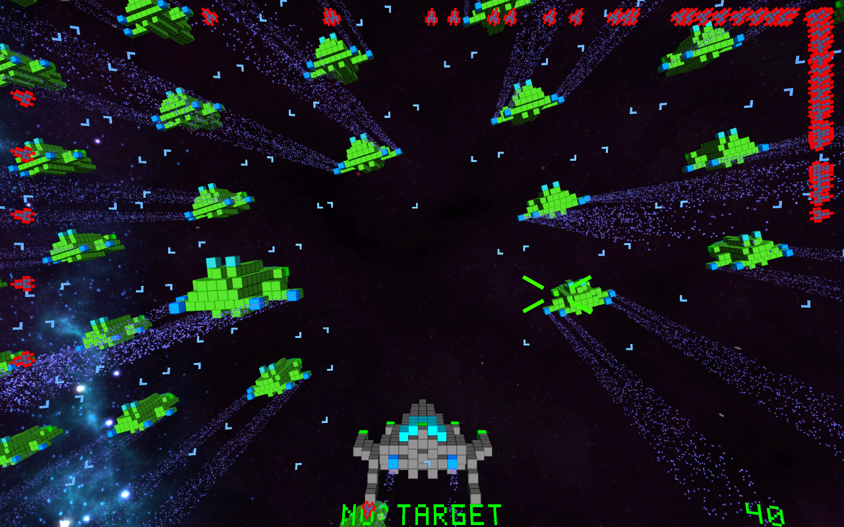
ParticleEngine

Slide 11
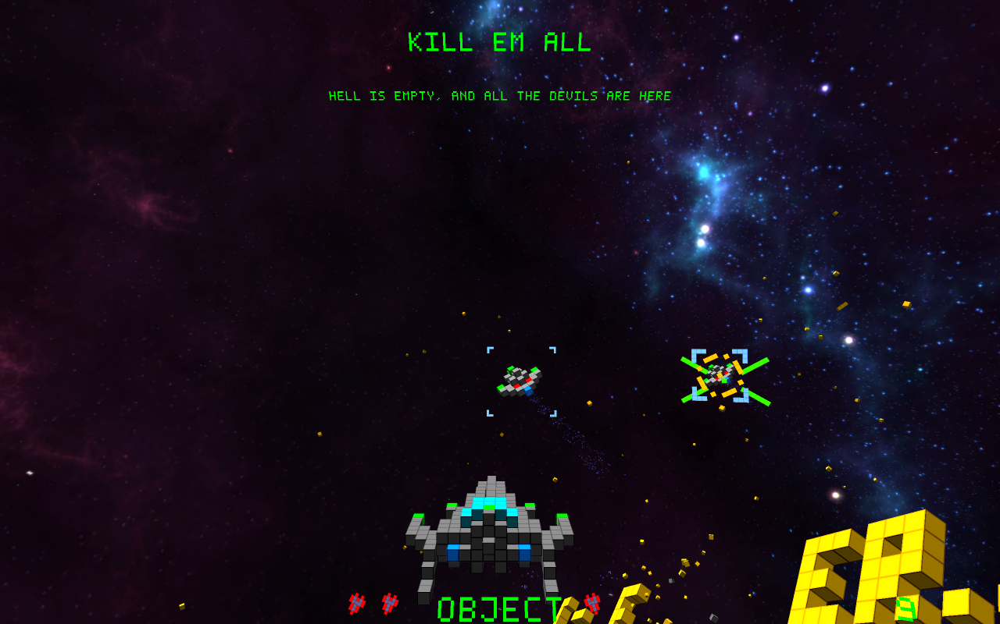
HUD

Slide 12
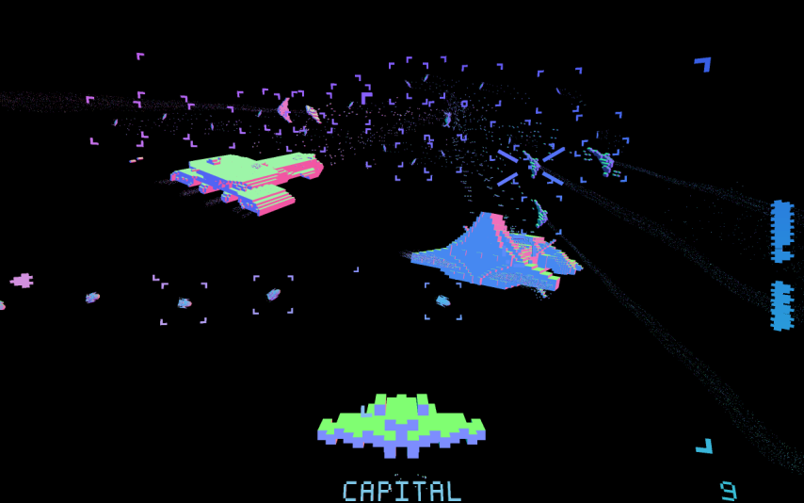
Post Processing & Effects

Slide 13
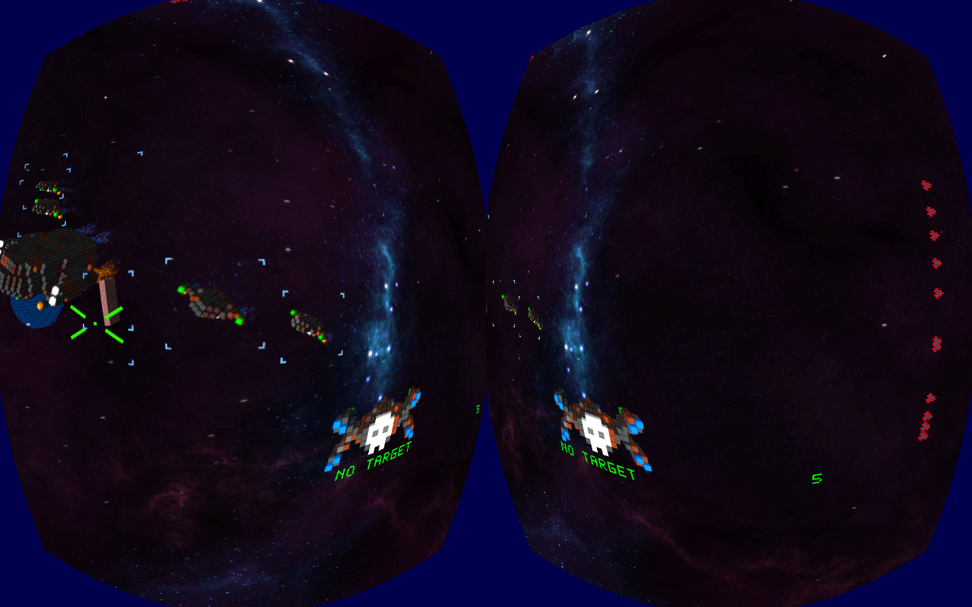
Oculus Rift

Slide 14
Misc.
3D Audio (engine-sound, explosions...)
Factions
Configureable gamepad and joystick support
Equipment, i.e. weapons and engines are changeable
Homing missiles
…

Slide 15
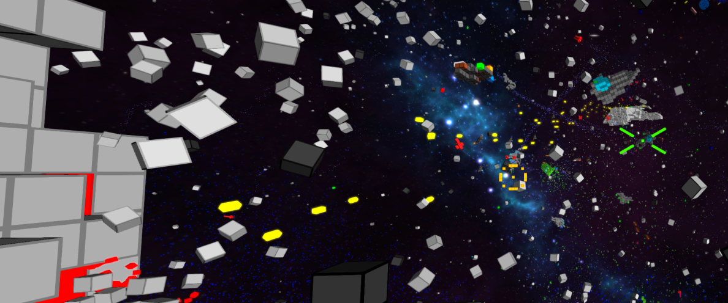
Behind the Scenes

Slide 16
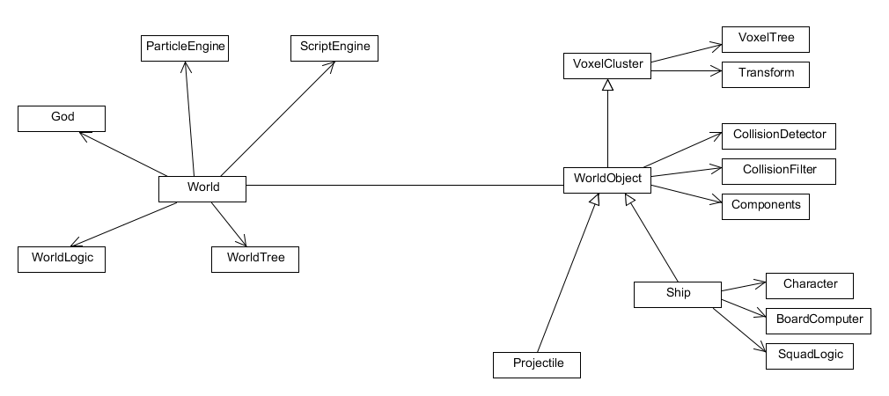
Quick Overview

Slide 17
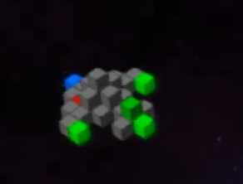
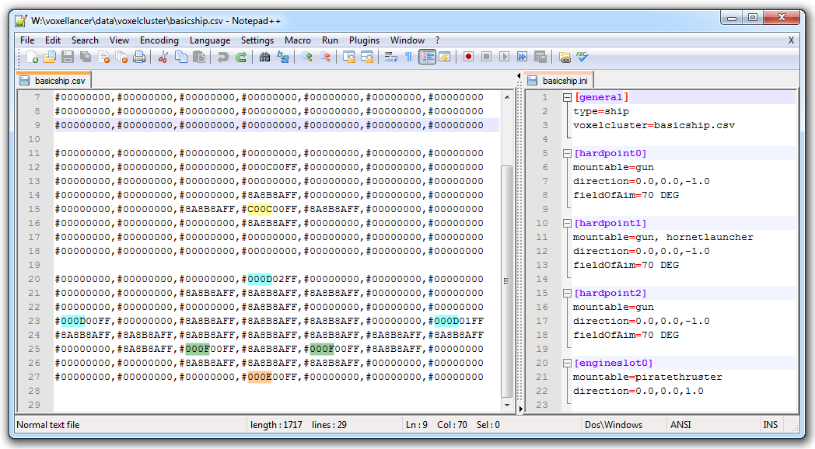
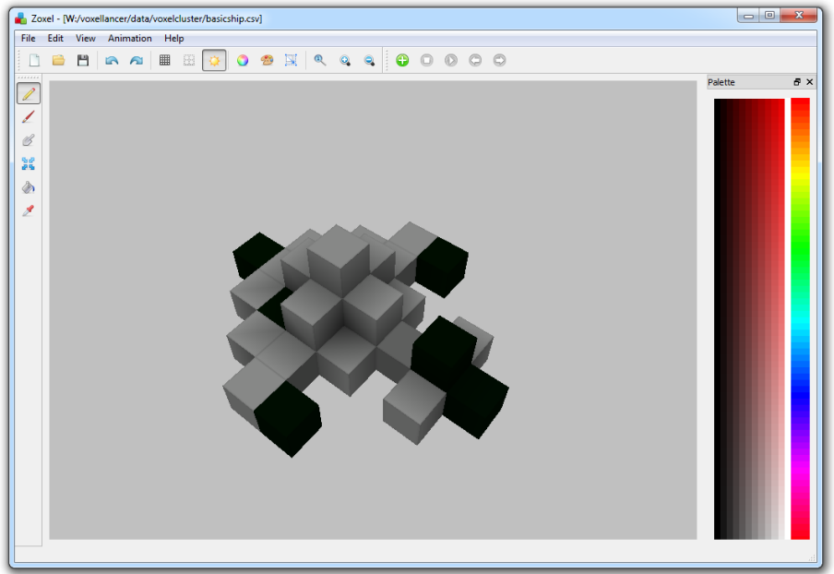
Models
Models are designed in Zoxel
HardPoint/EngineSlots encoded via special colors
Installed weapon/engine defines color
Modeled in Zoxel, configured via .ini

Slide 18
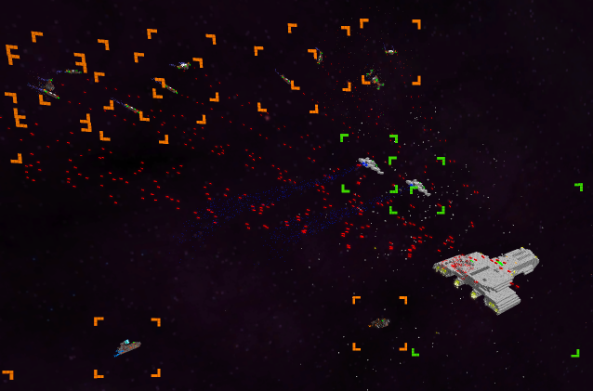
AI - Tasks
Tasks can be assigned to NPCs
Nested tasks for complex behaviour
NPCs can form squads to perform mutual tasks

Slide 19
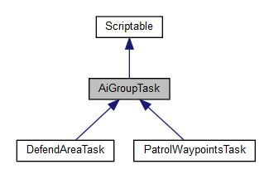
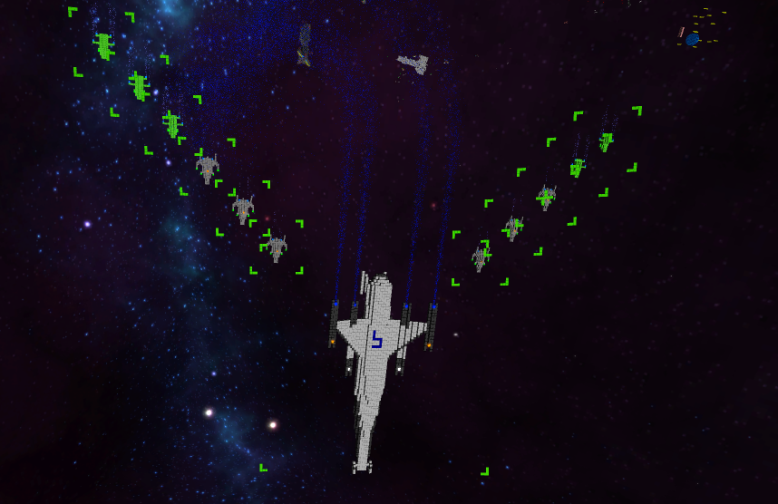
Group Tasks

Slide 20
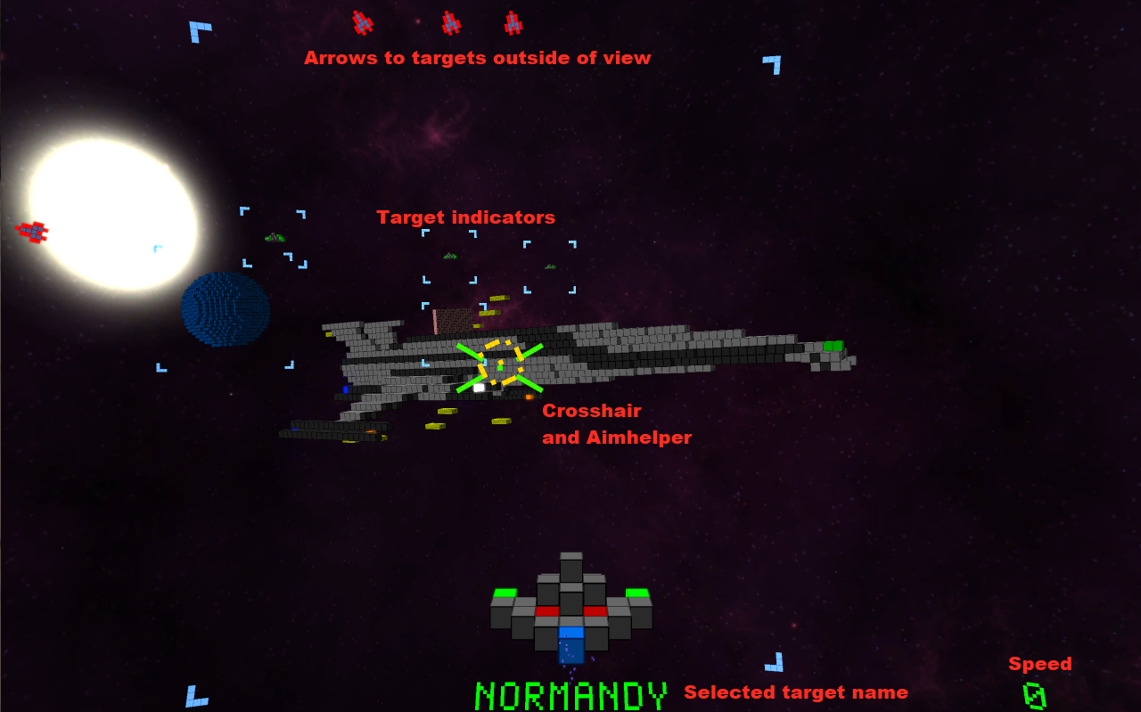
HUD
Notes:
HUD elements are placed on a sphere around the camera
Sphere (supposivly) allows easy integration with Oculus Rift
Creates a „HUD on Helmet“ illusion
Spherical HUD creates problems on the Rift for hudgets outside of the focus.
Due to the different viewing angles and distance to hudgets along the edges, the hudgets appear twice.

Slide 21
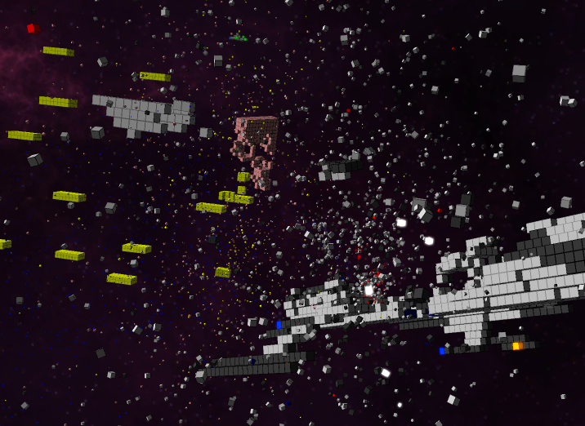
Particles
voxelparticledata.h
struct VoxelParticleData { glm::vec3 creationPosition; glm::vec3 creationEulers; glm::vec3 directionalSpeed; glm::vec3 angularSpeed; float creationTime; float deathTime; float scale; uint32_t color; float emissiveness; };
voxelparticle.vert:
float timeDelta = currentTime - creationTime;
vec3 particlePosition = directionalSpeed * timeDelta + creationPosition;
vec3 eulers = angularSpeed * timeDelta + creationEulers;
vec4 orientation = quat(eulers);
gl_Position = viewProjection * vec4(qtransform(orientation, v_vertex) * scale + position, 1.0);
→ Very few buffer updates neccessary!

Slide 22
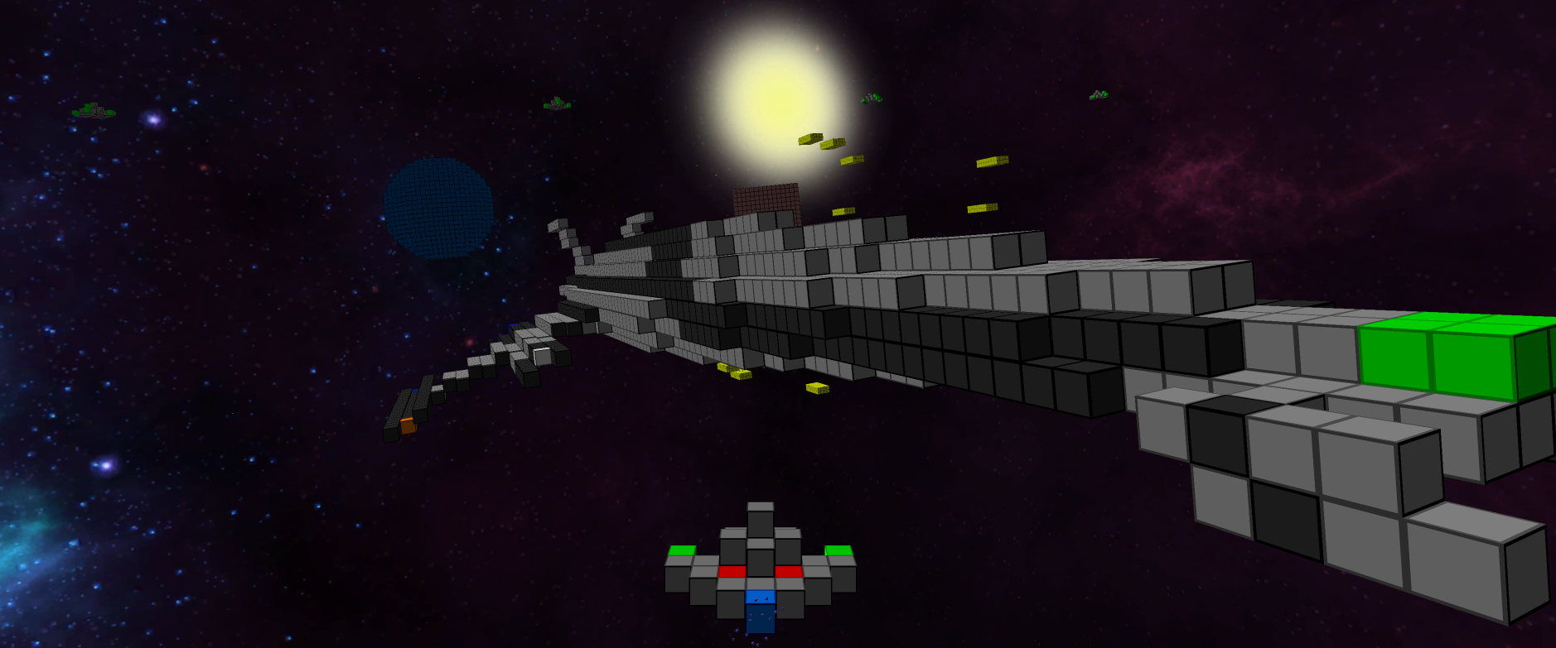
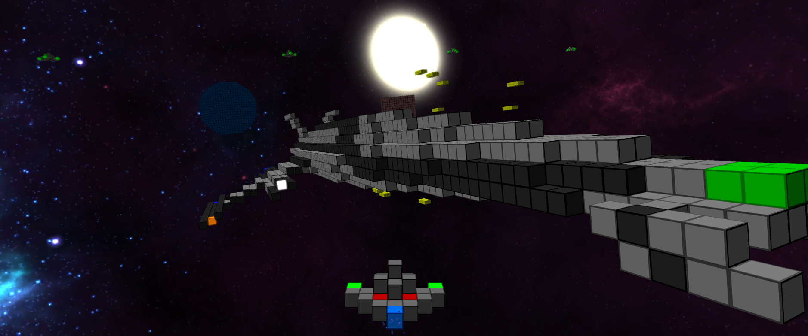
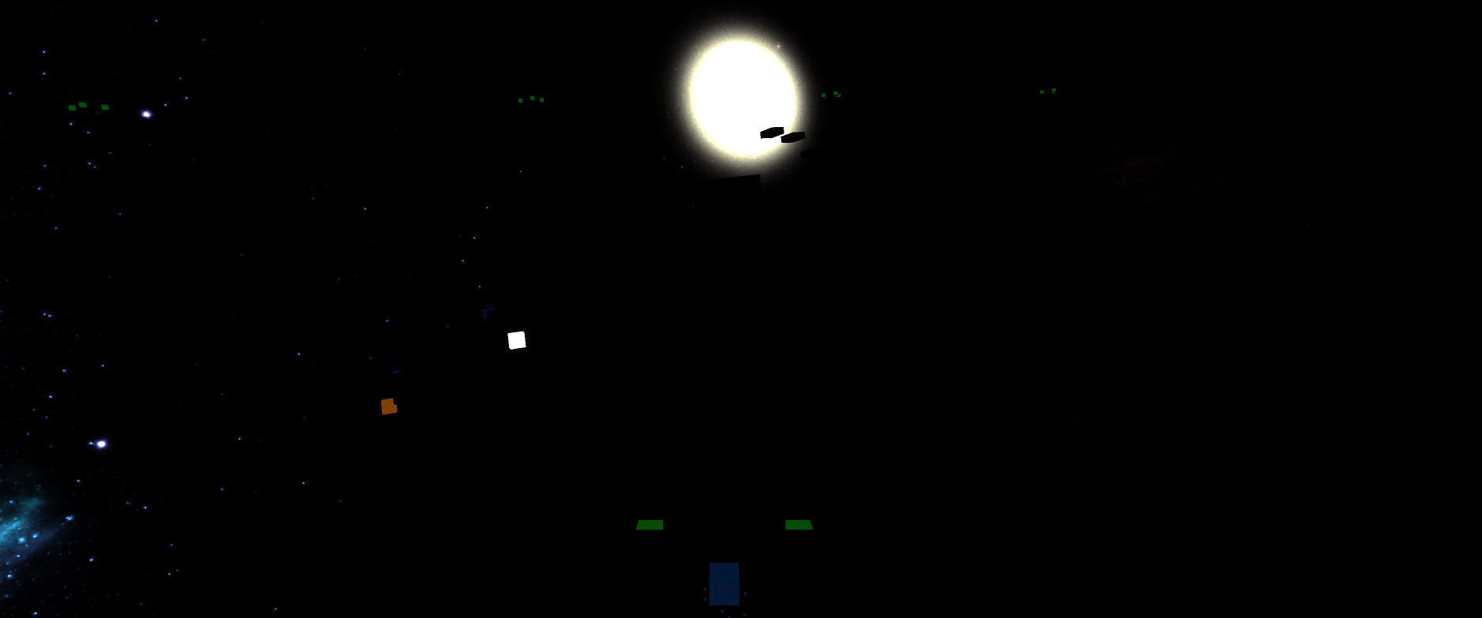

Postprocessing

Slide 23
RenderPipeline
auto pass = std::make_shared<PostProcessingPass>("blurv", m_quad);
pass->setInputMapping({ { "source", BufferNames::Emissisiveness } });
pass->setOutput({ BufferNames::BlurTmp });
pass->setFragmentShader("data/shader/postprocessing/blur.frag");
pass->setUniform("direction", glm::vec2(0, 1));
add(pass)

Slide 24
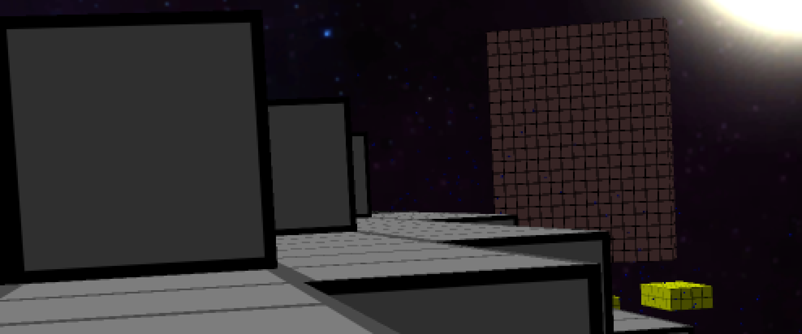
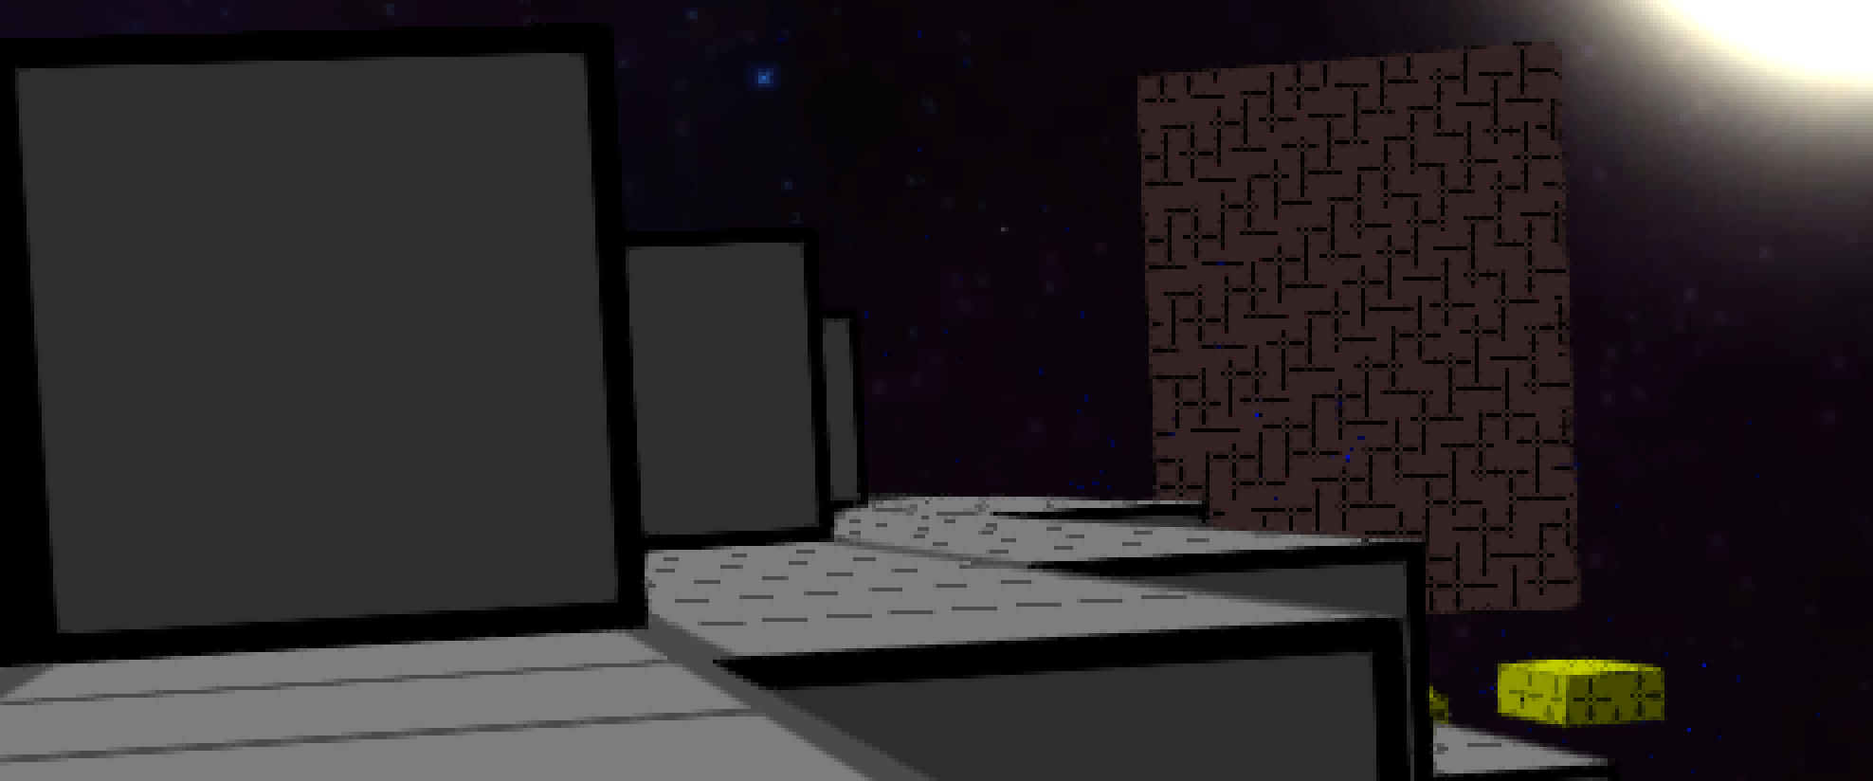

Antialiasing
fxaa
2x super sampling
without

Slide 25
Libraries & Tools
GLFW
GLOW
GLEW
GLM
SFML::Audio
OculusSDK
Lua + Elemate Lua bindings
Bandit (unit tests)
GitHub
github.com/voxelinc/voxellancer
Jenkins
Zoxel

Slide 26
